Slide 1
Presentation 14
Procedures and work instructions
Software quality infrastructure components
The need for procedures and work
instructions
Procedures and procedures manuals
Work instructions and work instruction
manuals
Procedures and work instructions:
preparation, implementation and updating

Slide 2
Infrastructure
Infrastructure components are tools employed to prevent software errors and promote the quality level of the entire organization.

Slide 3
Typical infrastructure components
* Procedures and work instruction.
* Quality support devices like templates and
checklists.
* Staff SQA training and certification
activities.
* Preventive and corrective actions.
* Software configuration management.
* Documentation and quality records control.

Slide 4
SQA procedures
Management quality review
Annual quality planning
Contract review
Development and quality plans
Quality assurance of the design
Document control
Subcontractors and suppliers file management
Pre-contract review for subcontract proposal
Acceptance tests for subcontracted software
Acceptance tests for customer-supplied software
Software development process

Slide 5
Configuration management
Unit tests and integration tests
Software system tests
Customer acceptance tests
Progress control for software development project
Control of design and code corrections
Installation and delivery
Control of quality records
Training and certification of employees
Maintenance plan
Change request management
Dealing with customers’ complaint

Slide 6
SQA work instruction subjects (examples)
Departmental work instructions
- Audit process for new software development subcontractors (supplier candidates)
Priorities for handling corrective maintenance tasks
Annual evaluation of software development subcontractors
On-the-job instructions and follow-up for new team members
Design documentation templates and their application
C++ programming instructions

Slide 7
Project management work instructions
Coordination and cooperation with the customer
Weekly progress reporting by team leaders
Special design report template and their application in the project
Follow-up of beta site reporting
Monthly progress reporting to the customer
Coordination of installation and customer’s team instructions

Slide 8
一般軟體發展包含活動 (例)
專案發展計畫
訂定軟體需求規格
軟體設計
資料庫設計
程式開發
測試
系統整合
製作操作手冊
製作維護手冊
建立安裝計畫

Slide 9
一般軟體發展包含活動程序 (例)
專案發展計畫程序(procedure)
軟體需求規格訂定程序
軟體設計程序
資料庫設計程序
程式開發程序
測試程序
系統整合程序
操作手冊製作程序
維護手冊製作程序
安裝計畫發展程序

Slide 10
軟體發展活動中預先建立之發展指引文件 (例)
專案發展計畫發展準則(criteria)
軟體需求規格發展準則
系統設計發展準則
資料庫設計發展準則
原始程式碼發展準則
測試計畫發展準則
測試報告建立準則
系統整合發展準則
操作手冊發展準則
維護手冊發展準則
安裝計畫發展準則

Slide 11
軟體發展活動中產出的工作產品 (例) (1/2)
專案發展計畫書
軟體需求規格書
系統設計文件
資料庫設計文件
原始程式碼
測試計畫書
測試報告書
系統整合文件
操作手冊
維護手冊
安裝計畫書

Slide 12
軟體發展活動中預先建立之產品樣板(例)
專案發展計畫書樣板(template)
軟體需求規格書樣板
系統設計文件樣板
資料庫設計文件樣板
原始程式碼撰寫樣板
測試計畫書樣板
測試報告書樣板
系統整合文件樣板
操作手冊樣板
維護手冊樣板
安裝計畫書樣板

Slide 13
軟體發展中可包含的品質保證活動(審查)
專案發展計畫書審查(Review)
軟體需求規格書審查
系統設計文件審查
資料庫設計文件審查
原始程式碼審查
測試計畫書審查
測試報告審查
系統整合文件審查
操作手冊審查
維護手冊審查
安裝計畫書審查

Slide 14
軟體發展中可包含的品質保證活動程序(審查)
專案發展計畫書審查程序(Review Procedure)
軟體需求規格書審查程序
系統設計文件審查程序
資料庫設計文件審查程序
原始程式碼審查程序
測試計畫書審查程序
測試報告審查程序
系統整合文件審查程序
操作手冊審查程序
維護手冊審查程序
安裝計畫書審查程序

Slide 15
軟體發展活動中預先建立之審查指引文件 (例)
專案發展計畫書審查準則(criteria)
軟體需求規格書審查準則
系統設計文件審查準則
資料庫設計文件審查準則
原始程式碼審查準則
測試計畫畫審查準則
測試報告審查準則
系統整合文件審查準則
操作手冊審查準則
維護手冊審查準則
安裝計畫書審查準則

Slide 16
軟體發展活動中預先建立之檢查表單(例)
專案發展計畫書檢查表單(checklist)
軟體需求規格書檢查表單
系統設計文件檢查表單
資料庫設計文件檢查表單
原始程式碼檢查表單
測試計畫書檢查表單
測試報告檢查表單
系統整合文件檢查表單
操作手冊檢查表單
維護手冊檢查表單
安裝計畫書檢查表單

Slide 17
軟體發展活動中預先建立之檢查報告樣板(例)
專案發展計畫書檢查報告樣板
軟體需求規格書檢查報告樣板
系統設計文件檢查報告樣板
資料庫設計文件檢查報告樣板
原始程式碼檢查報告樣板
測試計畫書檢查報告樣板
測試報告檢查報告樣板
系統整合文件檢查報告樣板
操作手冊檢查報告樣板
維護手冊檢查報告樣板
安裝計畫書檢查報告樣板

Slide 18
Please see Appendix 14A (P. 324)

Slide 19
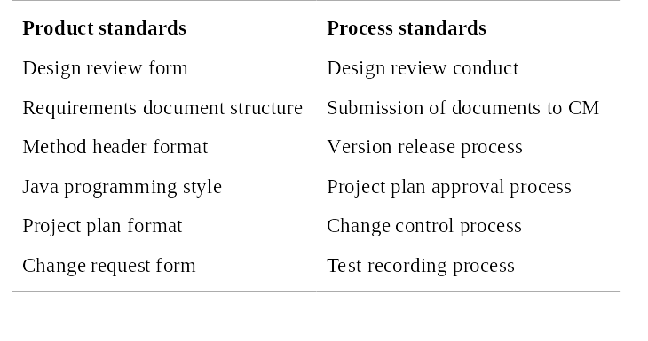
應建立之標準 (例)

Slide 20
Procedures and work
instructions - benefits
Performance of tasks, processes or activities in the most effective and efficient way.
Effective and efficient communication between development and maintenance teams that reduces the misunderstandings which lead to software errors.
Simplified coordination between tasks and activities performed by various teams that means fewer errors.

Slide 21
Conceptual hierarchy of
procedures and work instructions
International or national SQA standard
The organization’s SQA policy
The organization’s SQA procedures
SQA work instructions

Slide 22
Issues resolved by procedures
The Five W's
∗ What activities have to be performed
∗ HoW should each activity be performed
∗ When should the activity be performed
∗ Where should the activity be performed
∗ Who should perform the activity

Slide 23
Typical fixed table of
contents for procedure
Introduction *
Purpose
Terms and abbreviations *
Applicable documents
Method
Quality records and documentation
Reporting and follow up *
Responsibility for implementation *
List of appendices *
Appendices *
* Sections included only if applicable

Slide 24
Please see Appendix 14A (P. 322)

Slide 25
Factors affecting the contents
of the SQA procedures manual
* The types of software development and maintenance activities carried out by the organization
* The range of activities belonging to each activity type.
* The range of customers.
* The conceptions for the choice of method applied by the organization to achieved SQA objectives.

Slide 26
Motivations for
updating existing procedures
<>Technological changes in development tools, hardware, communication equipment, etc.
<> Changes in the organization's areas of activity
<> User proposals for improvement
<> Analysis of failures as well as successes
<> Proposals for improvements initiated by internal audit reports
<> Learning from the experience of other organizations
<> Experiences of the SQA team

